Slide 1
Image and Face Classification using, SVM, Regression Trees and Logistic Regression
By
Clyde Clarke

Slide 2
Outline
Problem Statement
Object Dataset
Image Classification
Feature Extraction
PCA
Classification Methods
SVM
Regression Trees
CNN
Evaluation
Hough
Color Histogram
Harlick
Face Dataset

Slide 3
The Object and Face Datasets
1) Caltech 101
Pictures of objects belonging to 101 categories. About 40 to 800 images per category. Most categories have about 50 images. Collected in September 2003 by Fei-Fei Li, Marco Andreetto, and Marc 'Aurelio Ranzato. The size of each image is roughly 300 x 200 pixels.
2) Labeled Faces in the Wild
Database of face photographs The data set contains more than 13,000 images of faces collected from the web. Each face has been labeled with the name of the person pictured.

Slide 4
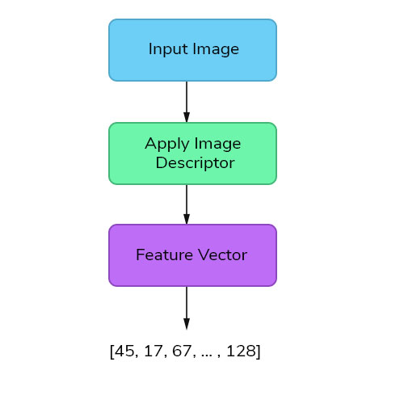
Image Classification

Slide 5
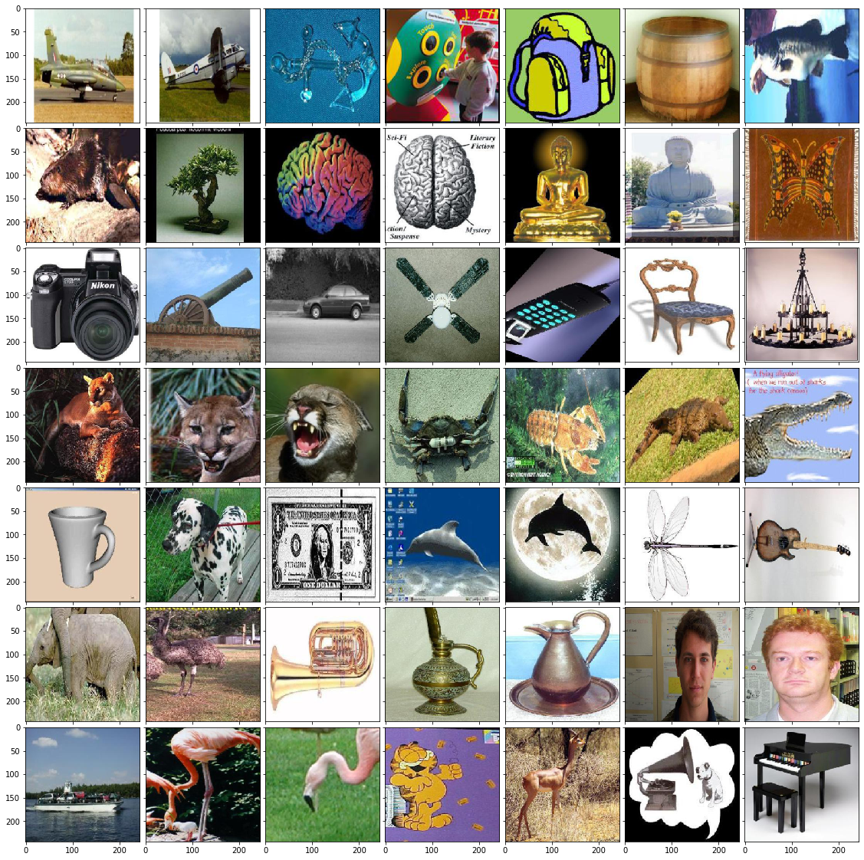
Image Classes Objects (50 +)

Slide 6
Feature Extraction
Convert RBG to GrayScale
PCA
PCA
Flatten image into vector array and apply PCA for first 150 components
Texture
Done to prevent gibbs phenomena at frame edges that would corrupt spectral analysis
Hue Moments
Find centers of color throughout the image
Texture
Moments
Color Histogram

Slide 7
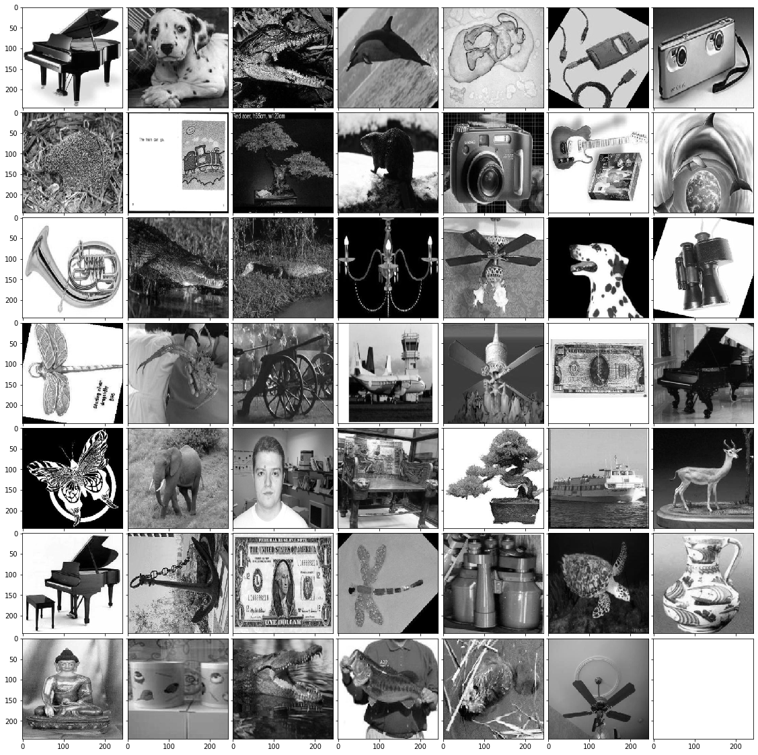
Grayscale Images

Slide 8
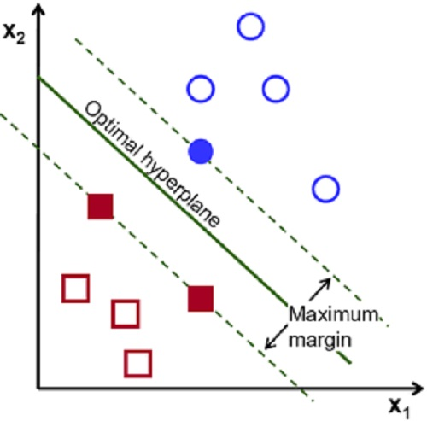
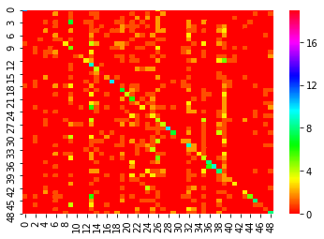
SVM
Large Margin Classifier
Maximizes the distance between decision boundary and support vectors
Kernel
Radial Basis Function
Accuracy
43% on training data and
26% accuracy on test data

Slide 9
SVM Class Test Scores

Slide 10
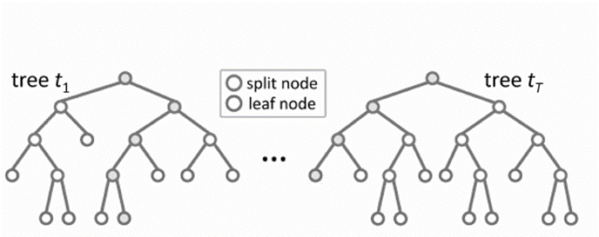
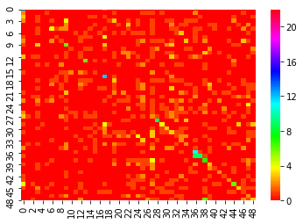
Random Forest
Random forests (RF) are a combination of tree predictors
Each tree depends on the values of a random vector sampled in dependently
The generalization error depends on the strength of the individual trees and the correlation between them
Accuracy
.87 on training data
.17 on test data

Slide 11
Random Forest Class Scores

Slide 12
Logistic Regression
Random forests (RF) are a combination of tree predictors
Each tree depends on the values of a random vector sampled in dependently
The generalization error depends on the strength of the individual trees and the correlation between them
Accuracy
.87 on training data
.12 on test data

Slide 13
Logistic Regression Class Test Scores

Slide 14
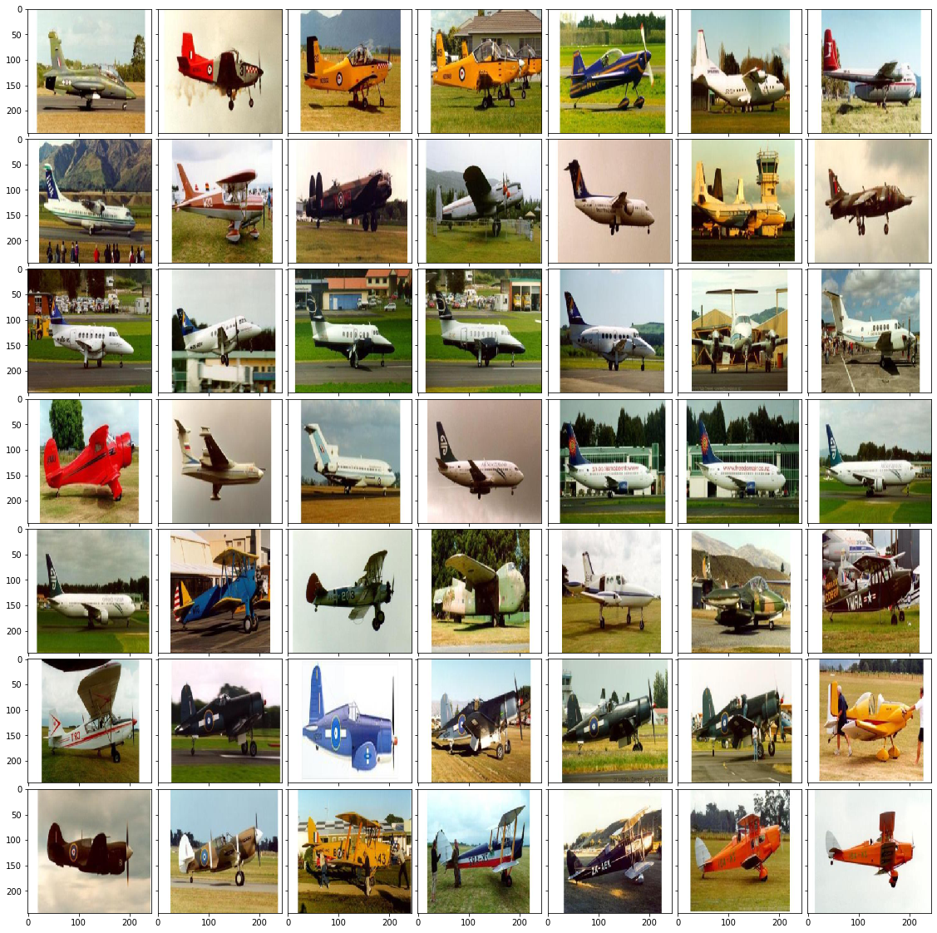
Classification Good
Specific classes from the data were scored with high accuracy
The airplanes were scored with 89% accuracy
Image background and orientation are mostly consistent within this class of the dataset
This is true regardless of the classification model used with higher accuracy for classes with consistent image orientation and background

Slide 15
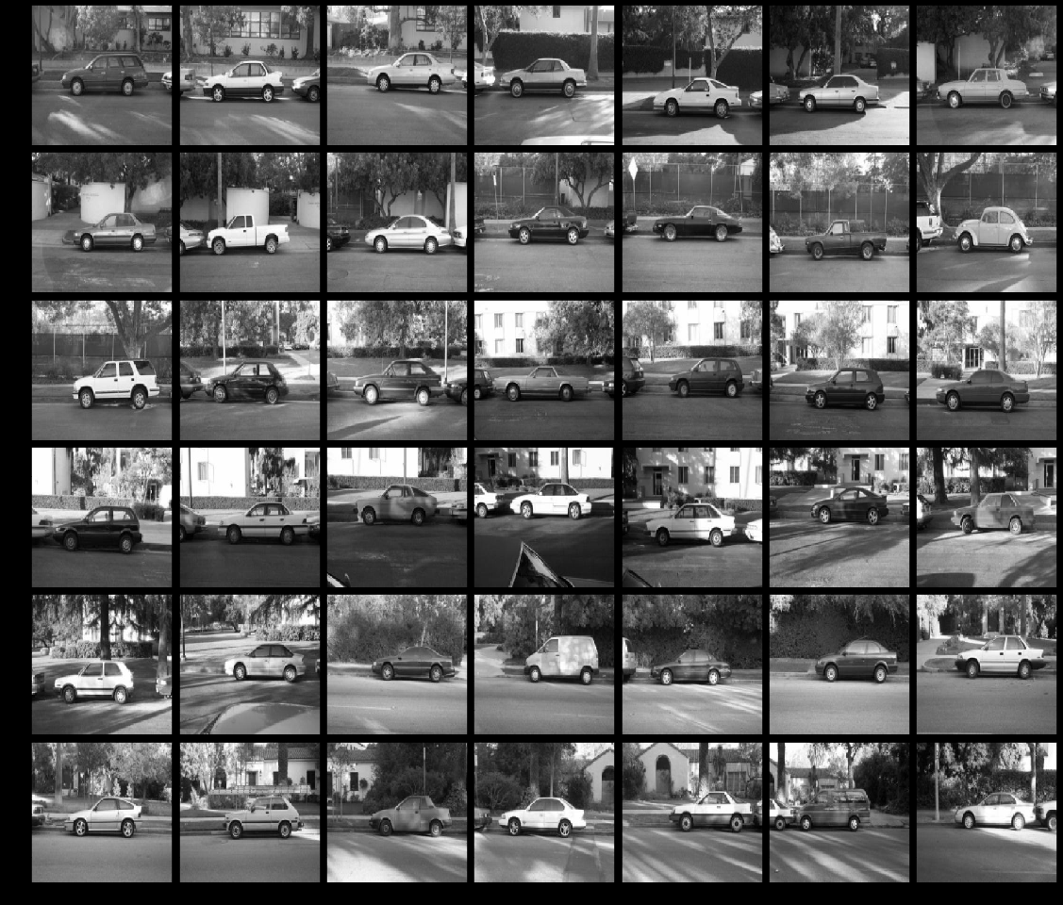
Classification Good
As seen the following class of cars has a consistent angle of image as well as a reasonably consistent background
The best performing model was able to obtain a 79% accuracy score on this class of data

Slide 16
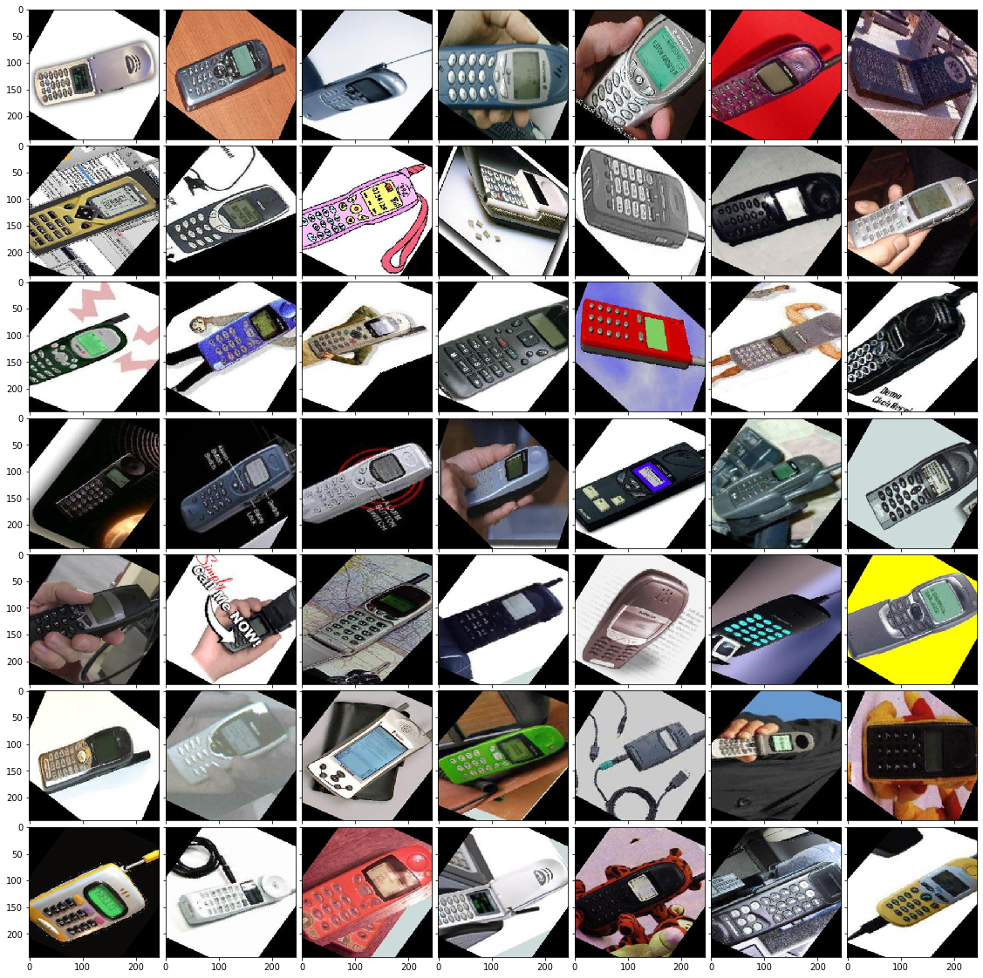
Classification Good
As seen the following class of cell has a consistent angle of image as well as a reasonably consistent background
The best performing model was able to obtain a 61% accuracy score on this class of data in SVM Training

Slide 17
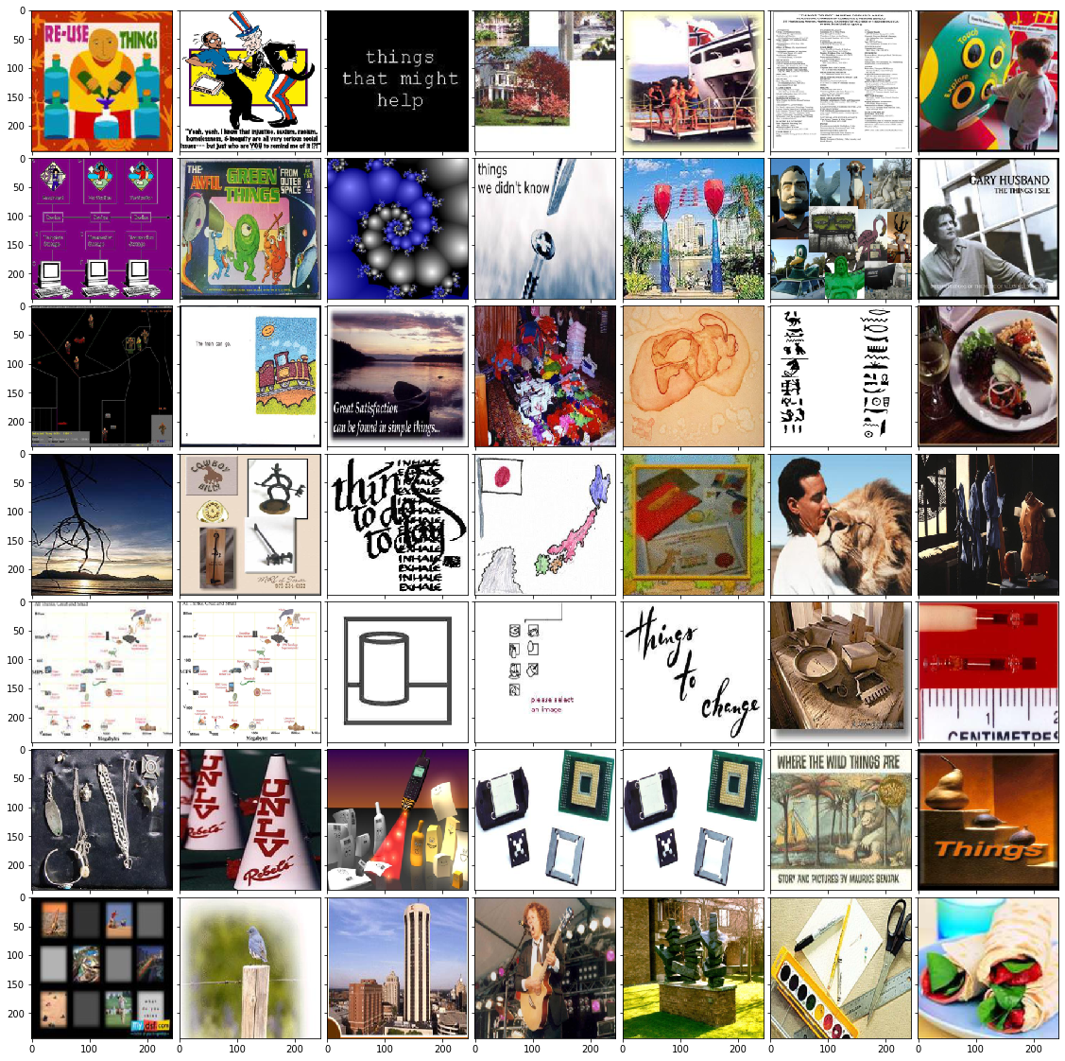
Classification Bad
Poorly performing classes had either inconsistent image content, orientation or background
Accuracy for most models range between 0-7% accuracy for this class labeled ‘Google Backgrounds”

Slide 18
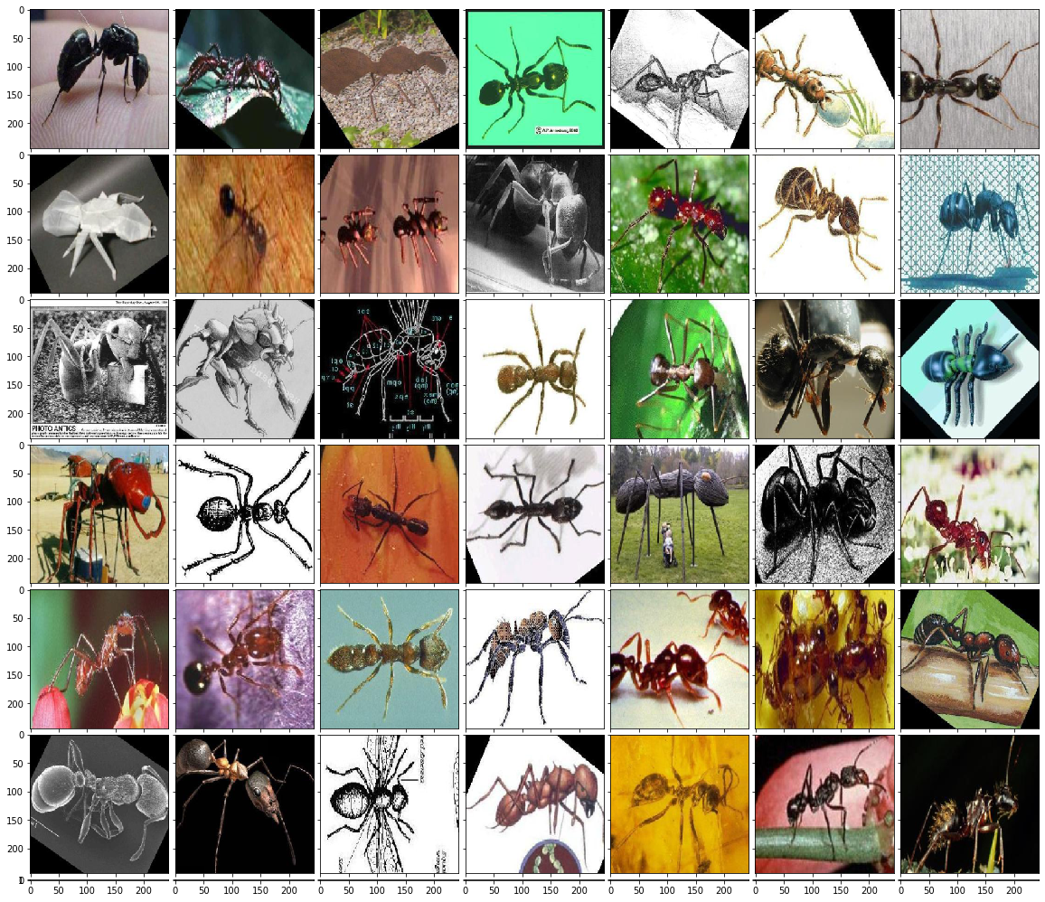
Classification Bad
Poorly performing classes had either inconsistent image content, orientation or background
Accuracy for most models range between 0-7% accuracy for this class labeled ‘Google Backgrounds”

Slide 19

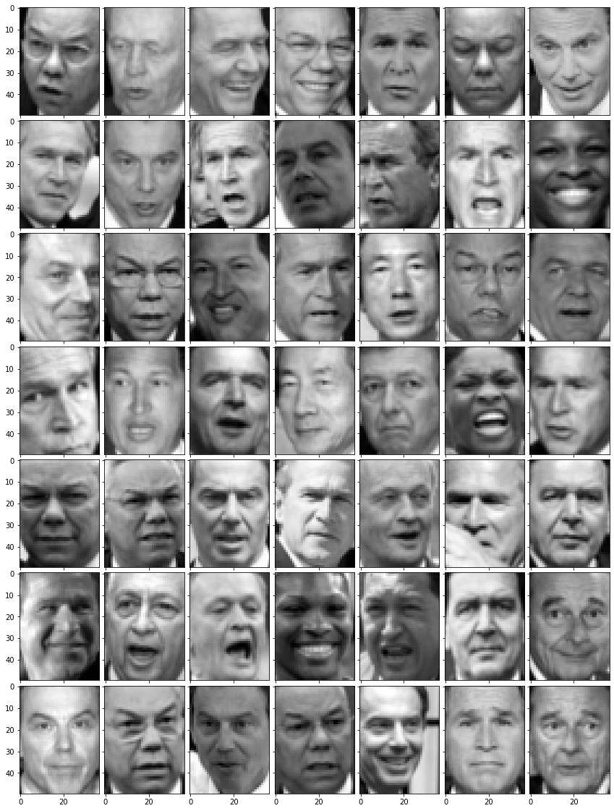
Labeled Faces in the Wild
Dataset consists of grayscale images with
consistent backgrounds

Slide 20
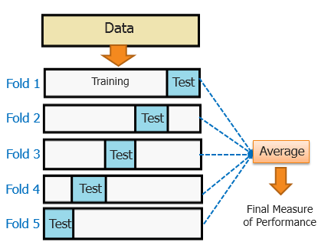
Training and Processing
5 Fold Crossvalidation was done using an 80/20 split of the data
PCA was performed along with the aforementioned feature extractions
A batch size of 32 and 100 epoch was used to train two convnet architectures

Slide 21
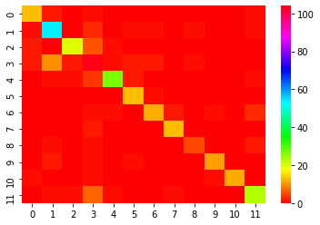
SVM Classification

Slide 22
Random Forest Classification

Slide 23
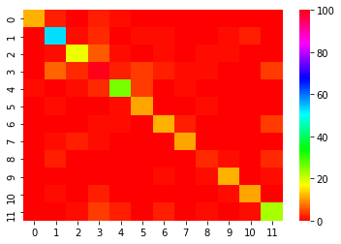
Logistic Regression Classifier

Slide 24
Conclusions
Feature Extraction was insufficient to deal with large variations in dataset
Choosing a dataset with less variation improved accuracy
Perhaps other features that account for object orientation and background could improve performance of supervised learning techinques

